Slide 1
Frontend Hackathon
Final report (Bakery or restaurant page)
Time completed: 48 hours

Slide 2
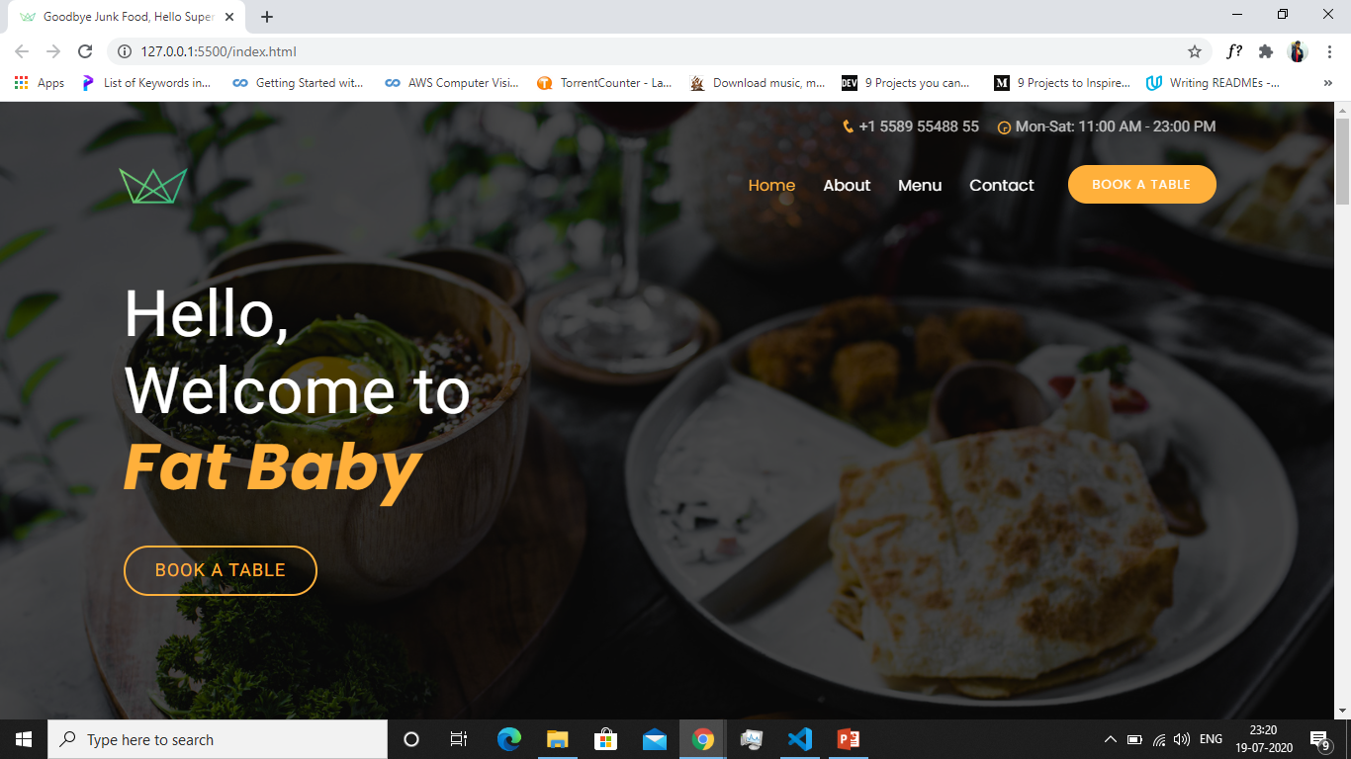

Slide 3
Components added
Navbar
About Section
Services offered
Menu (30 dishes)
Reservation section
Location map
Contact form
Footer

Slide 4
Technologies used
HTML
CSS
Bootstrap
Jquery
Reference
Projects made in Udemy and Coursera
Template from bootstrapmade.com for basic styling

Slide 5
Features in website
Smooth scrolling
Text appear animation
Dynamic filtering of menu dishes
Location map
Active link toggle on navigation while scrolling through the page
Nice hover effects
Seat reservation option availability
Nice parallax effect in background images
Fully responsive

